Slide 1
University of Diyala
College of Engineering
Department of Electronics Engineering
Course Number: U103
Course Name: Computer Science
Lecture (5)
Asst. Lect. Wurod Qasim Mohamed

Slide 2
ROM (Read Only Memory)
ROM stands for Read Only Memory. The memory from which we can only read but cannot write on it. This type of memory is non-volatile. The information is stored permanently in such memories during manufacture. A ROM stores such instructions that are required to start a computer. This operation is referred to as bootstrap. ROM chips are not only used in the computer but also in other electronic items like washing machine and microwave oven

Slide 3
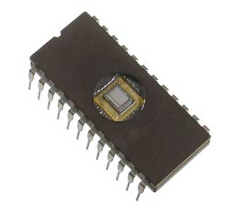

Slide 4
Let us now discuss the various types of ROMs and their characteristics.
MROM (Masked ROM)
The very first ROMs were hard-wired devices that contained a pre-programmed set of data or instructions. These kind of ROMs are known as masked ROMs, which are inexpensive.
PROM (Programmable Read Only Memory)
PROM is read-only memory that can be modified only once by a user. The user buys a blank PROM and enters the desired contents using a PROM program. Inside the PROM chip, there are small fuses which are burnt open during programming. It can be programmed only once and is not erasable.

Slide 5
EPROM (Erasable and Programmable Read Only Memory)
EPROM can be erased by exposing it to ultra-violet light for a duration of up to 40 minutes. Usually, an EPROM eraser achieves this function. During programming, an electrical charge is trapped in an insulated gate region. The charge is retained for more than 10 years because the charge has no leakage path. For erasing this charge, ultra-violet light is passed through a quartz crystal window (lid). This exposure to ultra-violet light dissipates the charge. During normal use, the quartz lid is sealed with a sticker.

Slide 6
EEPROM (Electrically Erasable and Programmable Read Only Memory)
EEPROM is programmed and erased electrically. It can be erased and reprogrammed about ten thousand times. Both erasing and programming take about 4 to 10 ms (millisecond). In EEPROM, any location can be selectively erased and programmed. EEPROMs can be erased one byte at a time, rather than erasing the entire chip. Hence, the process of reprogramming is flexible but slow.

Slide 7
The advantages of ROM are as follows −
Non-volatile in nature
Cannot be accidentally changed
Cheaper than RAMs
Easy to test
More reliable than RAMs
Static and do not require refreshing
Contents are always known and can be verified

Slide 8
Practical Laboratory Part

